Slide 1
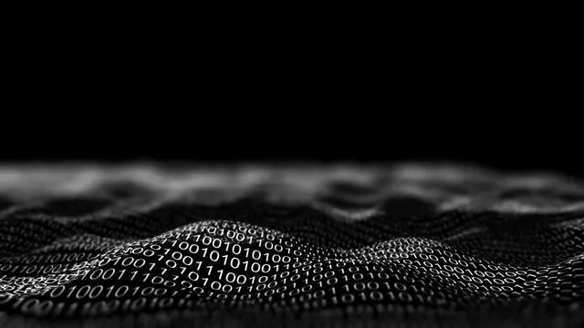
STUDENT NAME : DINAYA MADHURYA
STUDENT NUMBER : CL/OTHMFL3/11/56

Slide 2
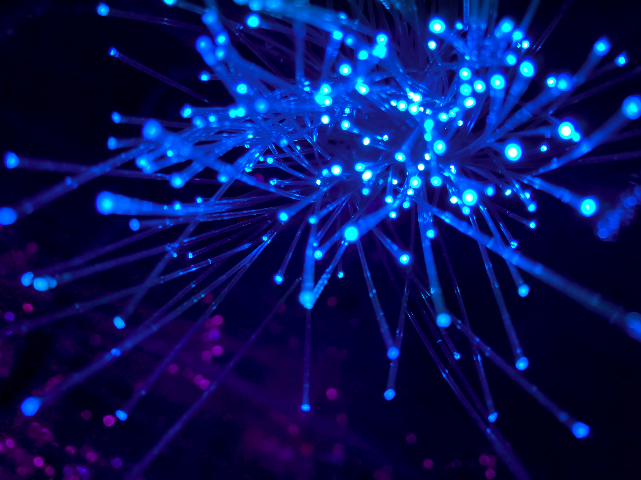
Table of contents
INPUT DEVICES
What is an Input?
What are Input Devices?
Most used types of input devices
Types of keyboards
Types of mouse
More examples of Input devices
OUTPUT DEVICES
What is an Output Device?
Examples of Output Devices
STORAGE DEVICES
What is a Storage Device?
Types of Storage Devices and its types with examples
PROCESSORS
What is a processor
The basic elements of a processor
Working of the processor
Components of CPU

Slide 3

What is an Input?
Input is any data or instructions entered into the
computer in the form of signals.
The input into the computer can be entered:
Through keyboard
By selecting commands on the screen and then clicking with mouse
By pressing finger on touch screen
By speaking into a microphone
By sending image through digital camera
By scanning data printed on paper through scanner

Slide 4

The devices that are used to enter data and instructions or commands into the computer are known as Input Devices.
Eyes and ears of computer.
Commonly used input devices are:
Keyboard
Mouse
Joystick
Light Pen
Digital Scanner
Floppy drives
Hard disks
CD drives are used for both input and output devices
What are Input Devices?

Slide 5

Most used type of Input Devices
The most used type of Input Devices are mouse and the Keyboard.
A keyboard contain keys for each alphabetic characters, digits and special characters. Used to feed data and instructions into a computer by pressing related keys on the keyboard
Pointing devices - Appears on the screen in Graphical User Interface. For example, an arrow appears on the screen in Windows environment. A pointing device is an input device that is used to control a pointer on the screen. Used to select item on the screen, to select commands from the command menu, to draw graphs etc. Mouse, Joystick, Trackball etc are examples of pointing devices
A mouse is used to input instruction with a pointer on the screen. Moved on the flat surface to control the movement of the cursor or pointer on the screen. Has two or three buttons on the top of its body. Used to select any option from the group of options by pointing the mouse pointer on it and then clicking one of the mouse buttons

Slide 6
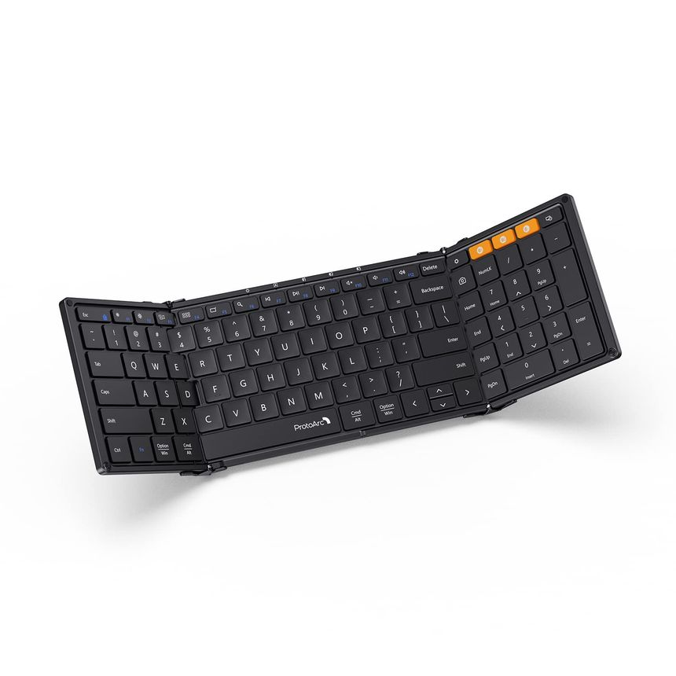
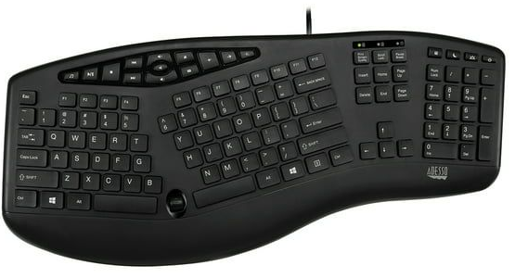
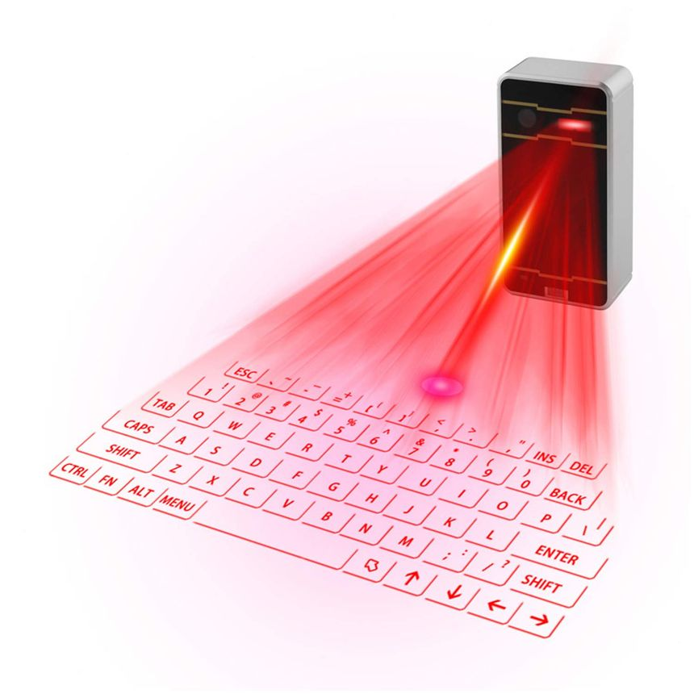
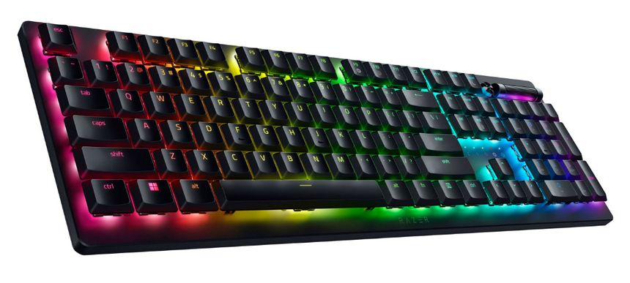
Types of keyboards
Portable keyboard
Ergonomic keyboard
Gaming keyboard
Virtual keyboard
1
2
4
3

Slide 7
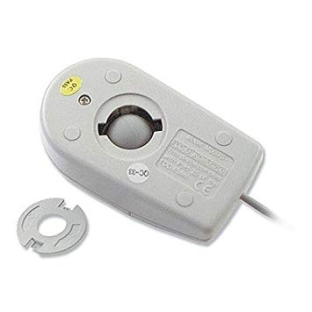
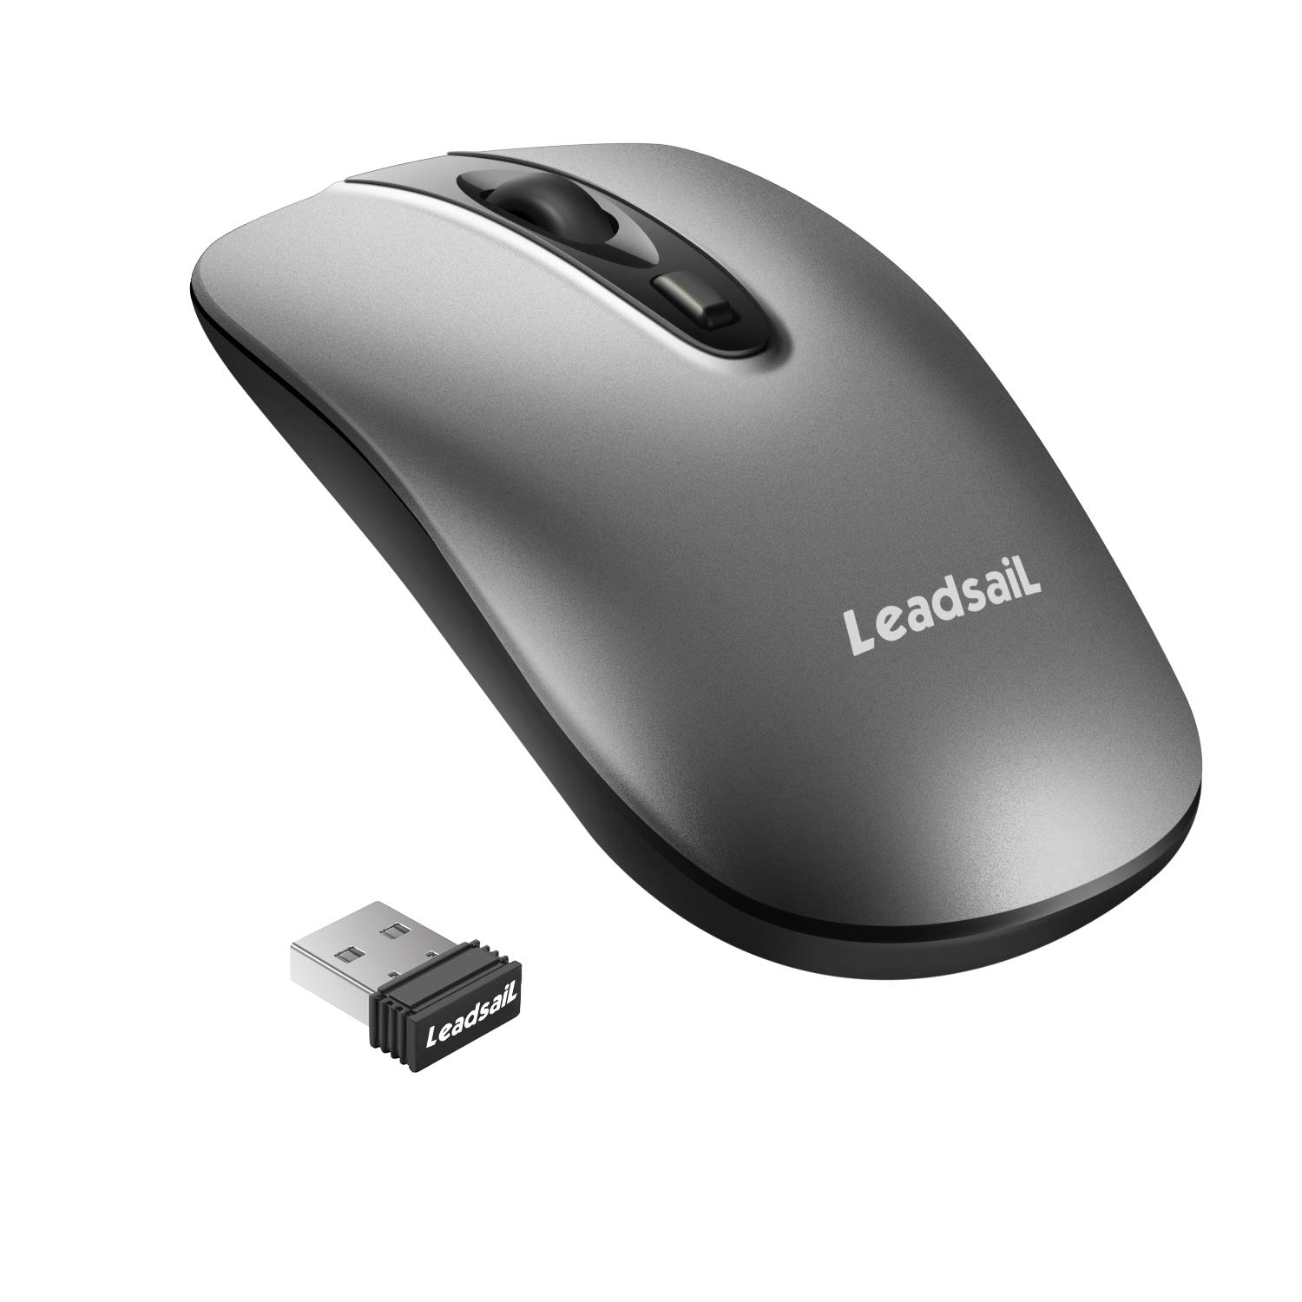
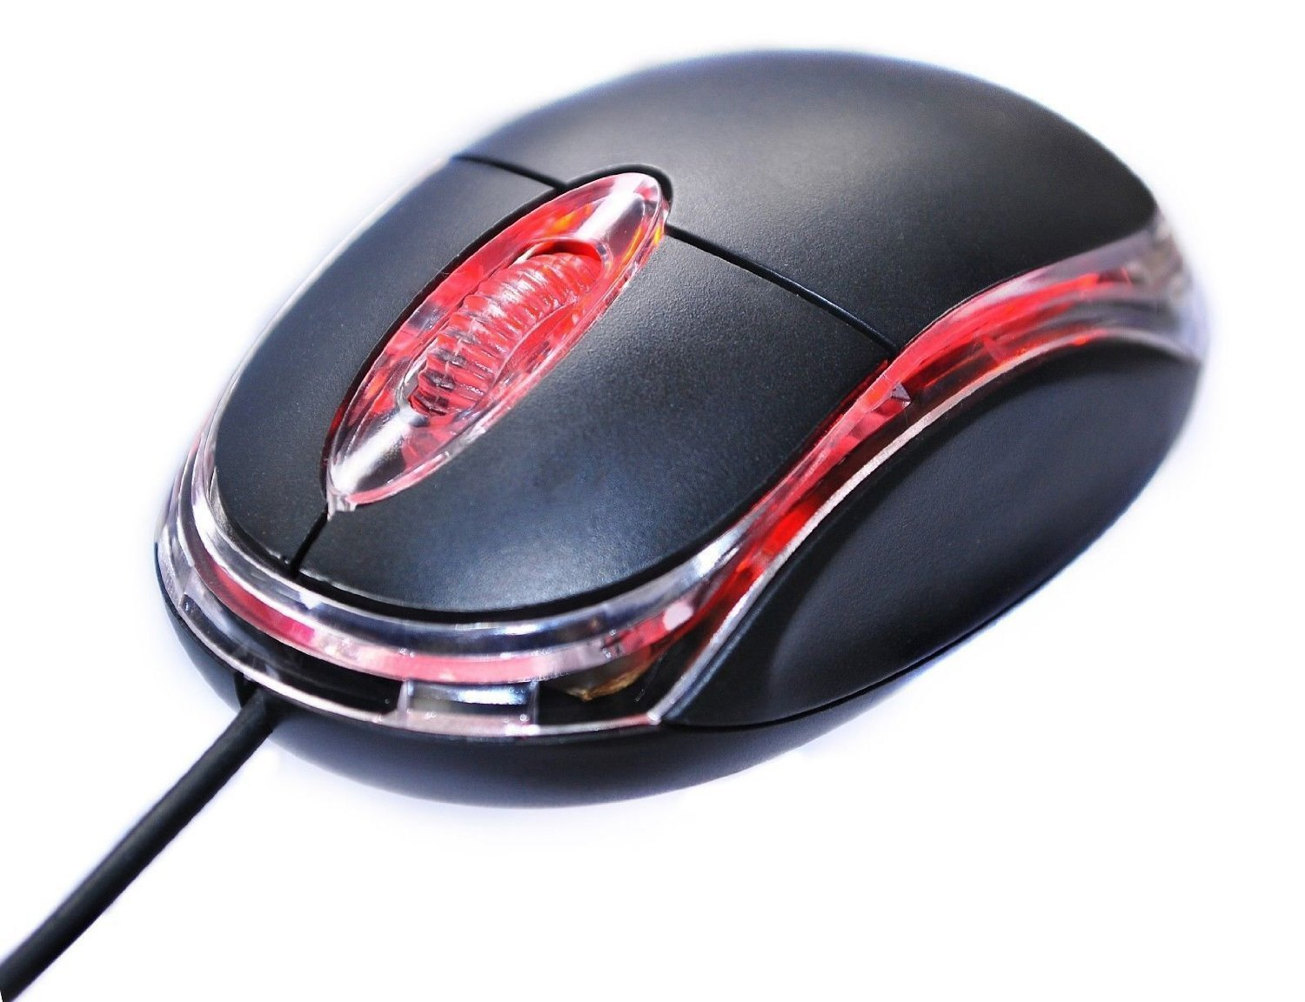
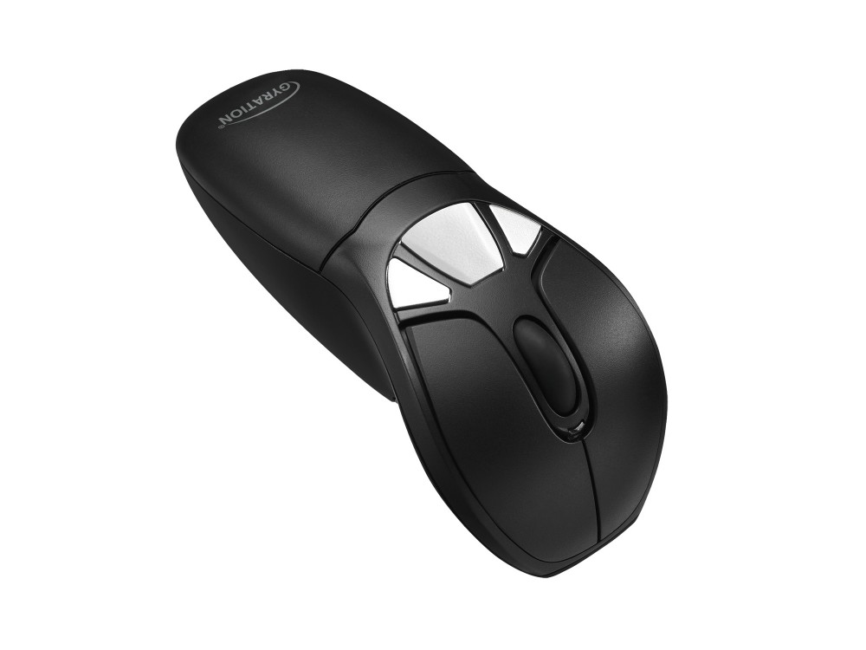
Types of mouse
Mechanical Mouse
Optical Mouse
Cordless Mouse
Air Mouse
1
3
2
4

Slide 8

More Examples of Input Devices.
Touchpad
Also known as track pad
Small, flat, rectangular, stationary pointing device
Sensitive surface of 1.5 or 2 inches
Mostly used in laptops
Mostly used in laptops
Joystick
Small box with a moving handheld stick and buttons
Stick is used to control the movement of the pointer on the screen
Button is pressed to activate certain events
Light PEN
Handheld pen shaped device with a photocell mounted at its front end
Used by engineers, graphic designers etc
Used in PDA’s and other hand held computers
Electronic Pen
To write texts and draw lines with the help of its pressure
Used in graphics application

Slide 9

Microphone
Input device used to enter the sound signals of user into the computer
Record the voice of the user in computer
Sound card translates the sound signals into digital signals for processing by computer
Also translates the sound digital signals back into the analog signals
Digital scanner
Light sensing input device Read images and text printed on paper and then translates into electronic form that can be processed and stored by the computer
Also called image scanner
Optical Reader
Device that uses a light source to read characters, marks printed on the paper etc
Converts them into the digital form that can be stored and processed in computer
Two main types of optical reader: Bar Code Readers, Optical Character Recognition
Digitizer
Flat, rectangular, electronic plastic board
Mainly used for drawing purposes in computer aided design applications
Makes easy to enter free-hand drawing in the computer

Slide 10
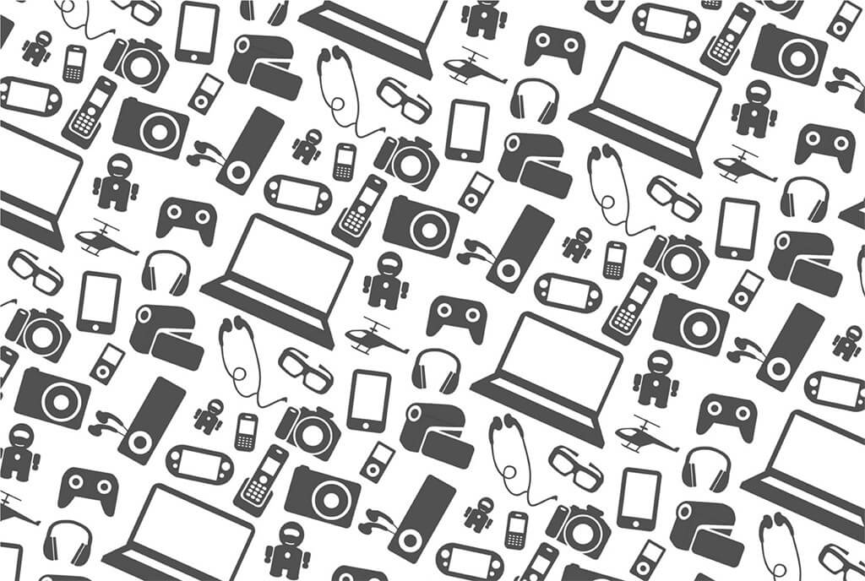
OUTPUT
DEVICES

Slide 11

What is an Output Device?
It’s a computer hardware that transform data into a form that humans can understand or, more traditionally, into a physically readable format for use with other non-computerized devices is known as an output device.
It maybe in the form of text, images/graphics, sound, video or touch
Examples include monitors, projectors, GPS devices, speakers, headphones, printers, optical mark readers and braille readers

Slide 12

Examples of Output Devices
1. Monitor/Display:
- Displays visual output in the form of text, images, and videos.
- Examples: LED monitors, LCD monitors, OLED displays.
2. Printer:
- Produces a hard copy of a document or image.
- Examples: Inkjet printers, laser printers, dot matrix printers.
3. Speakers:
- Output audio or sound generated by the computer.
- Examples: Computer speakers, headphones, external audio systems

Slide 13

4. Projector:
- Displays computer output on a larger screen or surface.
- Examples: Digital projectors, overhead projectors.
5. Plotter:
- Draws vector graphics. Commonly used in design and engineering for large-scale printing.
- Examples: Pen plotters, inkjet plotters.
6. Headphones:
- Provide audio output for an individual user.
- Examples: Wired headphones, wireless headphones, earbuds.
7. Braille Embosser:
- Converts electronic text into Braille characters for visually impaired users.
- Examples: Braille embossers.

Slide 14

8. Sound Cards:
- Internal or external devices that process and output audio signals from a computer.
- Examples: Internal sound cards, USB audio interfaces.
9. Haptic Devices:
- Provide tactile feedback to the user, simulating a sense of touch.
- Examples: Haptic gloves, force feedback joysticks.
10. 3D Printers:
- Create three-dimensional objects by layering materials based on digital models.
- Examples: Fused deposition modeling (FDM) printers, stereolithography (SLA) printers.
11. Data Projector:
- Projects computer-generated images onto a screen or other surfaces.
- Examples: Digital projectors, multimedia projectors.

Slide 15

STORAGE DEVICES

Slide 16

What is a Storage Device?
A storage device is a hardware device or a component within a computer or other digital device that is used to store and retrieve digital data. These devices provide a means for computers to permanently or temporarily hold data, allowing users to save files, install software, and store information for future use. Storage devices can be broadly categorized into two types: primary storage (volatile memory) and secondary storage (non-volatile memory).

Slide 17

Types of Storage Devices and its types
Primary Storage (Volatile Memory):
RAM (Random Access Memory): Used for temporary storage of data that is actively being used or processed by the computer. It is volatile, meaning it loses its content when the power is turned off.
Secondary Storage (Non-Volatile Memory):
Hard Disk Drive (HDD): A magnetic storage device that uses spinning disks to store data. It provides large storage capacities for long-term data storage.

Slide 18
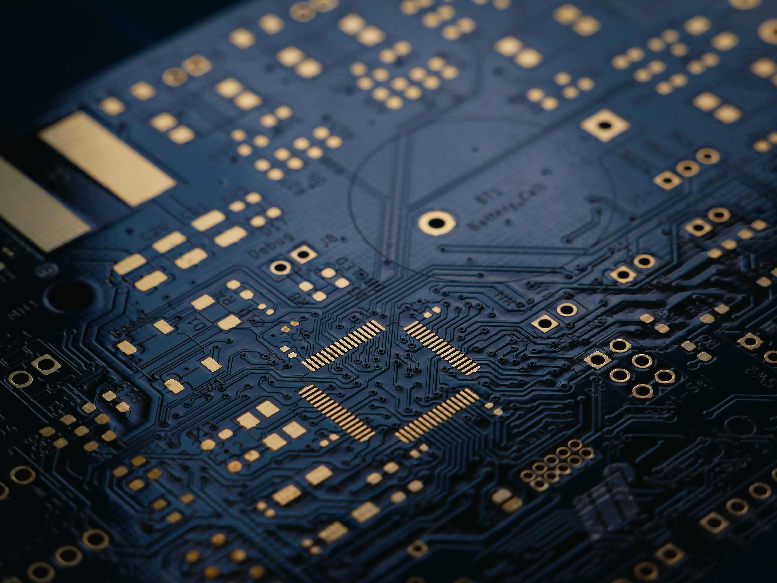
Solid State Drive (SSD): Uses NAND-based flash memory to store data. SSDs are faster and more durable than HDDs, making them suitable for both primary and secondary storage.
USB Flash Drive: A portable, small-sized storage device that uses flash memory for data storage. It is often used for transferring and storing files between computers.
CD/DVD/Blu-ray Disc: Optical storage media used for storing large amounts of data, including software, music, and videos.

Slide 19
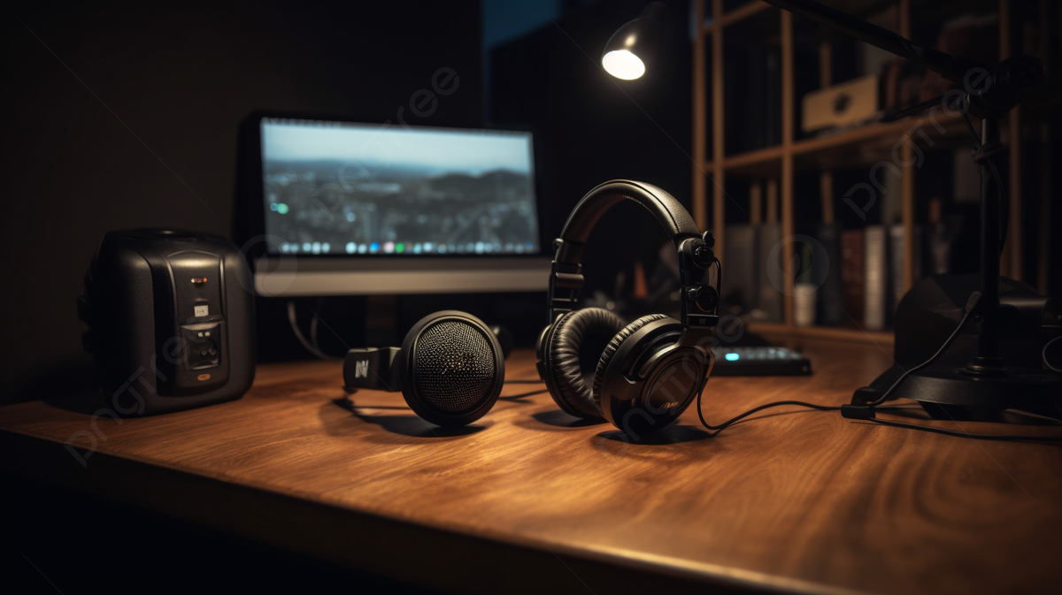
Memory Cards: Small, removable storage devices commonly used in cameras, smartphones, and other portable devices.
External Hard Drive: A standalone hard drive that connects to a computer externally, providing additional storage capacity.
Network Attached Storage (NAS): A storage device that is connected to a network, allowing multiple users or devices to access and share data

Slide 20

PROCESSORS

Slide 21
WHAT IS A PROCESSOR?
The logic circuitry that responds to and processes the basic instructions that drive a computer is known as a processor. It is regarded as the primary and most important integrated circuitry chip in a computer because it is in charge of interpreting the majority of the computer's commands.

Slide 22
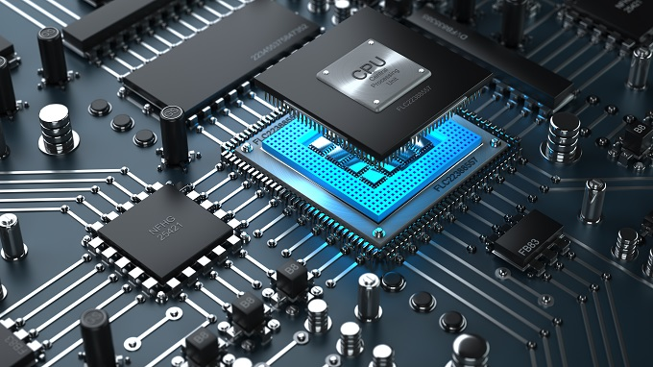
The Basic elements of a processor
The arithmetic logic unit (ALU), which carries out arithmetic and logic operations on the operands in instructions.
The floating point unit (FPU), also known as a math coprocessor or numeric coprocessor, a specialized coprocessor that manipulates numbers more quickly than the basic microprocessor circuitry can.
Registers, which hold instructions and other data. Registers supply operands to the ALU and store the results of operations.
L1 and L2 cache memory. Their inclusion in the CPU saves time compared to having to get data from random access memory (RAM).

Slide 23
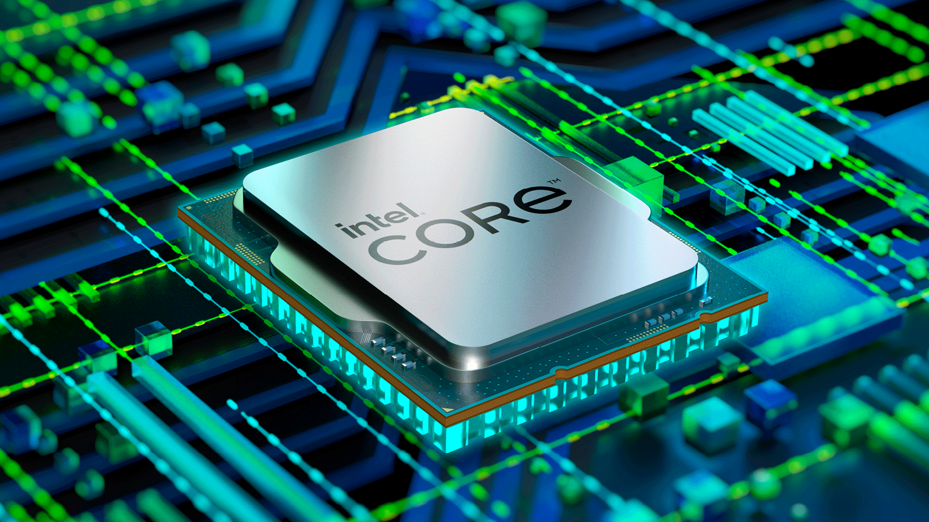
Working of the processor
Working of processor mainly consist four steps, Fetch, Decode, Execute and Write back.
Fetch : During the fetch step, the processor retrieves program instructions from memory.
Decode : In this step, the instruction is broken down into parts.
Execute : CPU performs the operation implied by the program instructions.
Write back : During the write back step, the Processor writes back the results of execution, to the computer's memory.

Slide 24
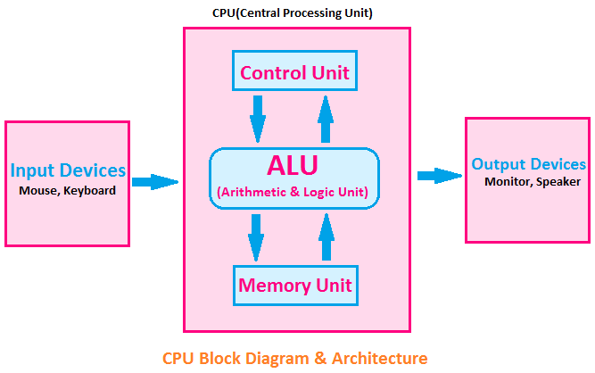
COMPONENTS OF CPU

Slide 25

Thank you!

